Slide 1
Rescuing Digital Media with LAMMP
Matthew McKinley
Digital Project Specialist
UCI Libraries
mjmckinl@uci.edu

Slide 2
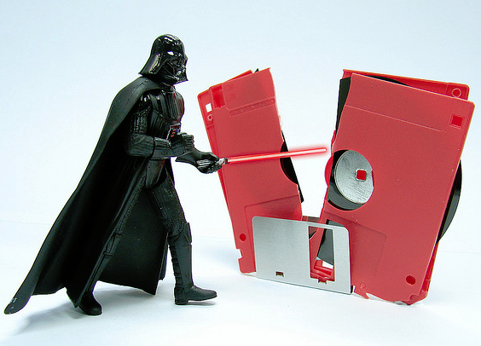
The Problem:
Valuable content on Digital Media
Digital Media is INACCESSIBLE
Digital Media is FRAGILE
Avg. lifespan of commercial CD-R: 10 years
Preservation too TECHNICAL
“I Find Your Lack of Space Disturbing”, http://www.flickr.com/photos/nhussein/
Notes:
Problem: you have important stuff on obsolete digital media. How do you save it?
First issue is ACCESS. Older media needs older hardware & software
You can’t read a floppy disk without a floppy drive, and obsolete hardware gets harder to find every year.
After you access the disk content, what if it’s in a format modern software can’t read?
Even if you can read them, floppies and CDs are fragile
A lot can go wrong: A disk can get damaged or fail to read, a user can accidentally move or delete an important file
Media isn’t built to last. Your standard CD-R may fail on you in a decade or less!
Tools exist, but they’re expensive or geared toward IT specialists. And commercial vendors can charge over $100 dollars per disk!

Slide 3
The Solution:
LAMMP will:
Capture content from digital media
Automatically generate:
Descriptive info for access
Technical info for preservation
Convert to modern file formats
Preserve (and share with others!)
Legacy
Archival
Media
Migration
Platform
Notes:
For all these problems, LAMMP is the answer
no tool is complete without a snazzy acronym, I’ve dubbed it the Legacy Archival Media Migration Platform
LAMMP is a workstation and process that:
rescues digital content
generates information about the files and process
Preserves all files in a restricted archive for future use
Low cost: Built entirely on free software and cheap or donated hardware.
Because the software source code is available, I can customize or swap out tools as needed.
Easy: follow the manual, click on a script, enter some info and you’re done.
For all these problems, LAMMP is the answer
LAMMP is an all in one service that will
rescue digital content
generate descriptive and technical info for easy access and preservation
Convert your files to modern, accessible formats
We’ll even upload your files to a secure cloud storage solution so you can safely preserve your files and share them with others!

Slide 4
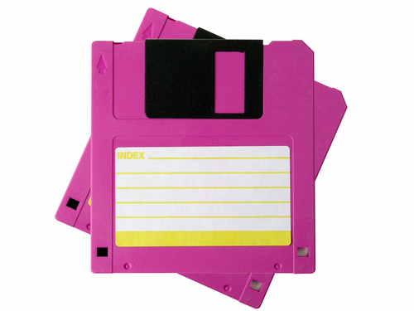
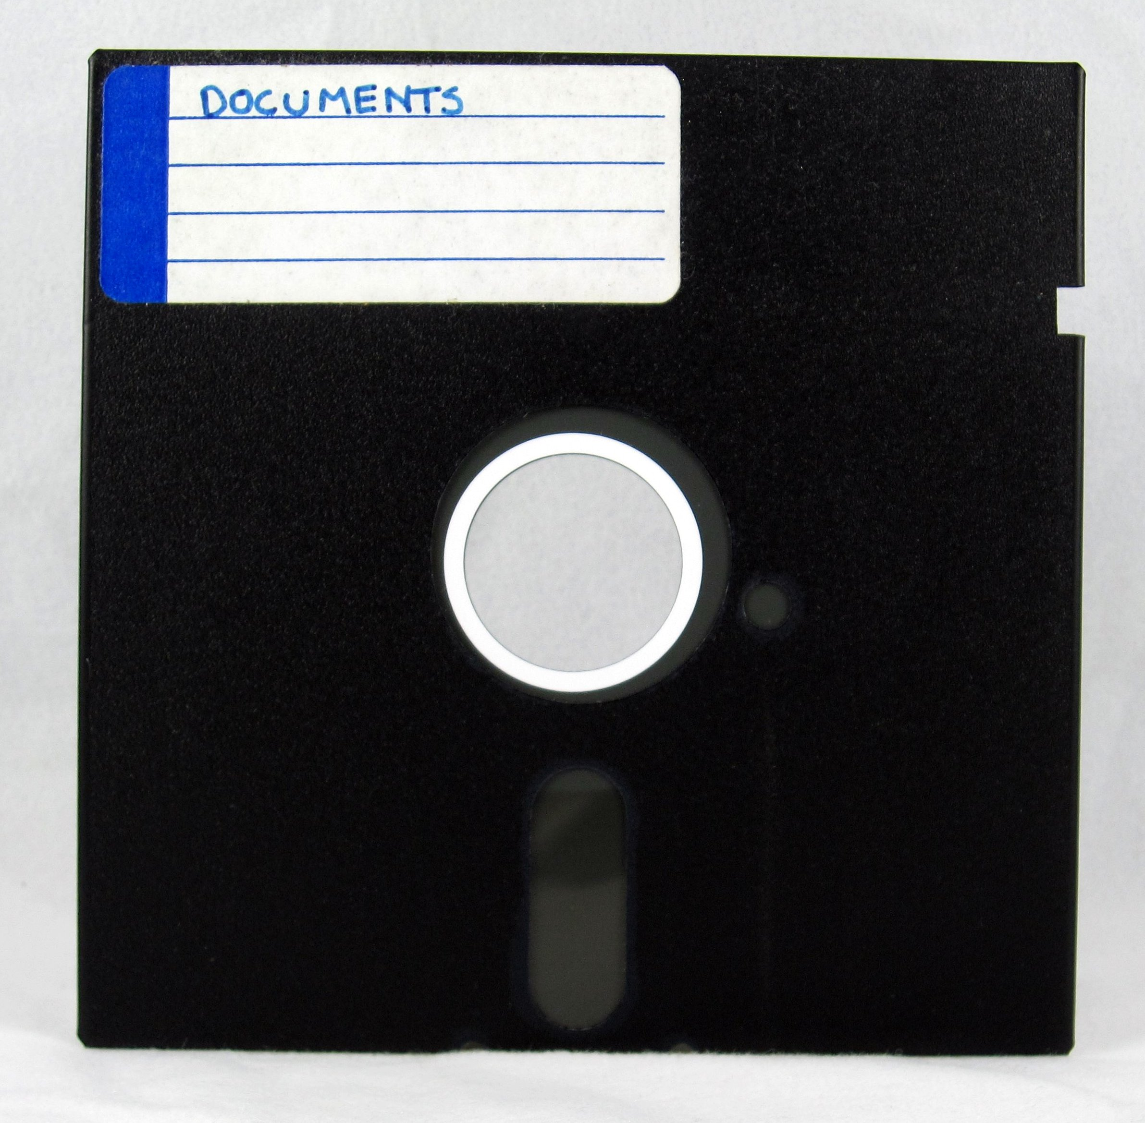
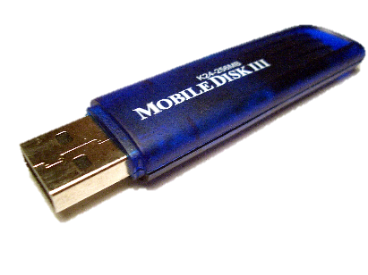
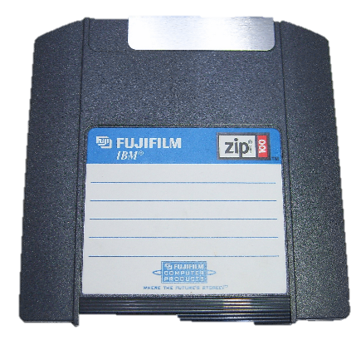
USB ZIP CDs DVDS
INPUT
3.5” 5.25”
Floppy Disks
Notes:
LAMMP handles all sorts of obsolete media types, as well as more current storage devices such as USB and DVD-R.
It can even package entire computer directories and email boxes for access and preservation

Slide 5
LAMMP Workflow
FTKImager
ClamAV
Notes:
LAMMP works by stringing together a variety of software tools into one efficient process.
First an exact copy of the media or disk image is taken.
Then the content is checked for viruses
And descriptive information gets generated about the media and content files
Finally, the files get packaged and preserved or delivered directly to you

Slide 6
Your Files:
OUTPUT
Cataloged!
Converted!
Preserved!
Filename
Location
Size
Date Last Modified
Notes:
The result?
Your files are cataloged in an easy to read spreadsheet
Converted to modern formats supported by every operating system
And preserved in Merritt, a preservation system from the California Digital Library that lets you share, manage and preserve your content
Talk to a UCI Libraries subject librarian to learn more about what LAMMP and other Digital Scholarship Services can do for you. There’s no case too small or file format too weird. LAMMP is here to light the way toward your legacy computer files!

